Slide 1
AUHM – An Ultimate Hackathon Matrix
Built for Hack Node India 2025
Developed during OpenxAI & BlockseBlock 5-Day AI Workshop
By Kavya Sharma
CSE Undergraduate student : Rayat Bahra University, Mohali

Slide 2

The Hackathon Headache
For aspiring tech innovators, the journey to hackathon success often begins with a frustrating search. Many students struggle to find hackathons that align with their interests and skill levels, leading to missed opportunities and underprepared participation.
Discovery Dilemma
Clarity Crisis
Difficulty in discovering relevant hackathons amidst a sea of options.
Lack of clear guidance on required skills and optimal preparation strategies.
Guidance Gap
Absence of a personalized roadmap or instant, actionable advice.

Slide 3
AUHM: Your Hackathon Navigator
AUHM – An Ultimate Hackathon Matrix offers a comprehensive, AI-powered solution to these challenges, serving as the ultimate one-stop platform for hackathon enthusiasts.
Unified Discovery: Explore hackathons across diverse domains: AI/ML, Web3, Cloud, Healthcare, and more.
Structured Roadmaps: Access curated roadmaps, essential tricks, and innovative project ideas to kickstart your hackathon journey.
AI-Powered Guidance: An intelligent chatbot provides personalized tips, skill recommendations, and preparation strategies.
Empowering Community: Connect with fellow hackers and mentors, fostering a collaborative learning environment.

Slide 4





Key Features at a Glance
AUHM is designed for intuitive usability and powerful functionality.
Smart Search & Filtering
AI Chatbot Assistant
Roadmaps & Guidance
Effortlessly find hackathons tailored to your interests and tech stack.
Instant, personalized advice and answers to all your hackathon queries.
Curated paths and expert tips to master specific domains and technologies.
Dynamic Theming
Smooth Interactions
Seamlessly switch between light and dark modes for optimal viewing comfort.
Engaging and responsive interactive animations for a superior user experience.

Slide 5
Robust System Architecture
AUHM is built on a modern, scalable, and deployment-ready architecture, ensuring high performance and reliability.
Frontend
Backend
React 18 + TypeScript
Express.js with REST APIs
Tailwind CSS for rapid styling
Drizzle ORM for robust data management
shadcn/ui for accessible components
PostgreSQL as the primary database
Framer Motion for fluid animations
All data is securely stored in Neon DB, providing a serverless Postgres experience, making AUHM truly deployment-ready from day one.

Slide 6








Under the Hood: Our Tech Stack
AUHM leverages a curated selection of cutting-edge technologies to deliver a seamless and powerful user experience.
Frontend
Backend
Database
React, Vite, Tailwind CSS, shadcn/ui
Node.js / Express.js
PostgreSQL + Drizzle ORM
State Management
Build Tools
TanStack Query, Zod, React Hook Form
Vite + ESBuild
This robust combination ensures efficient development, optimal performance, and maintainability for future enhancements.

Slide 7

Intelligent AI Integration
The core of AUHM's personalized experience lies in its sophisticated AI integration, powered by local-first models.
Ollama + Gemma:2B Model
We utilize the lightweight Ollama + Gemma:2B model, enabling efficient local execution and ensuring privacy and speed for the AI chatbot.
Context-Aware: The AI understands user queries to provide highly relevant hackathon discovery and personalized tips.
Future-Ready: Designed for future compatibility with more powerful models like Llama 3.2, Mistral 7B, and Phi-3-mini.
Offline Capability: The local model ensures basic AI features can function even without constant internet access.
Seamless Experience: An expandable chatbot widget with smooth animations integrates naturally into the UI.

Slide 8
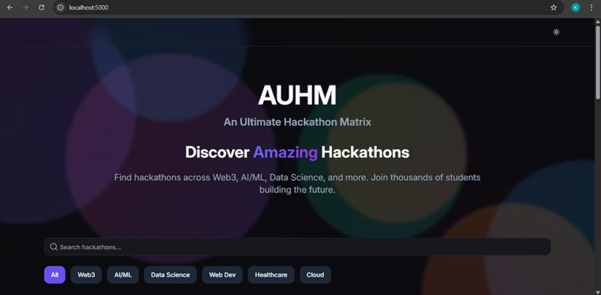
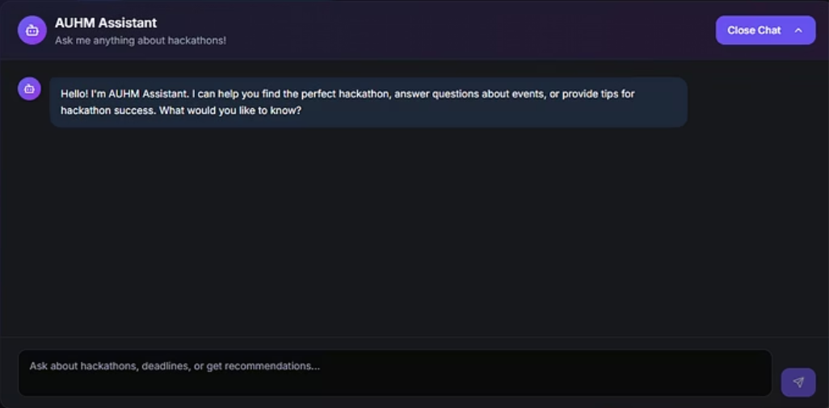
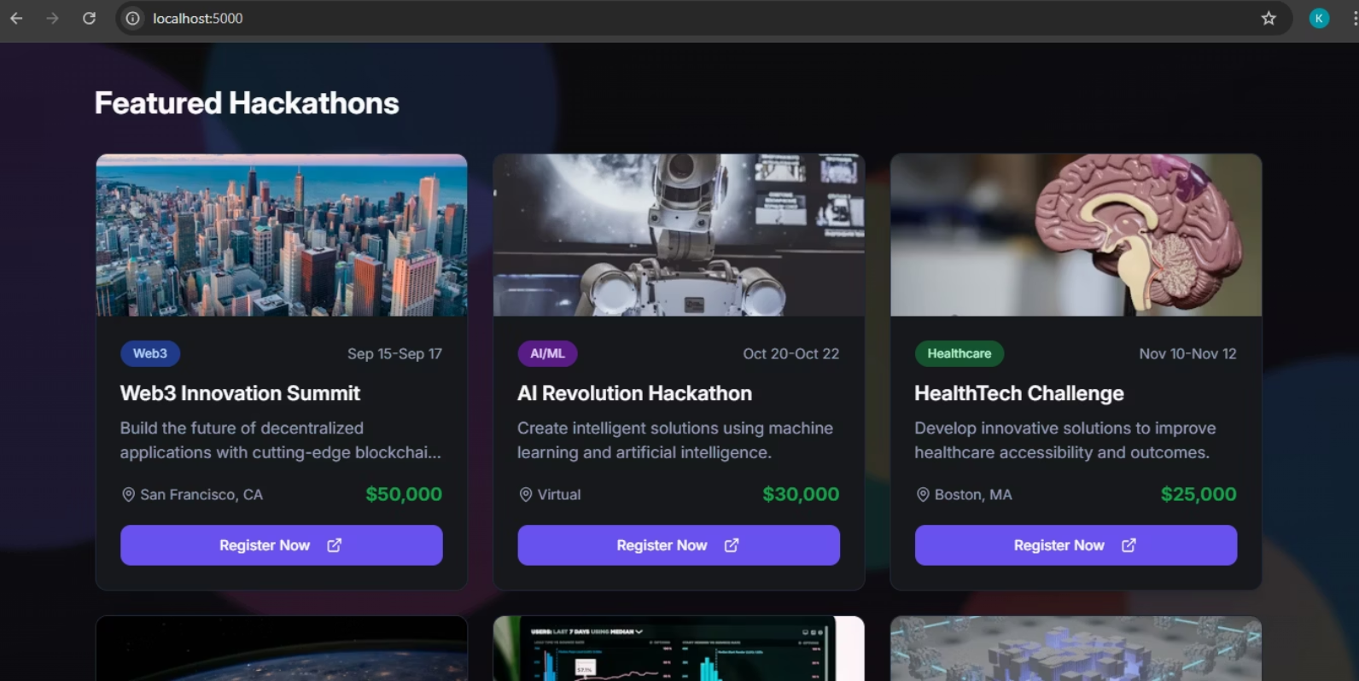
AUHM in Action: Demo Sneak Peek
Witness the seamless user experience and powerful features of AUHM through these glimpses of the platform.
These visuals show the simple design and main features that make AUHM a helpful tool for every developer.

Slide 9
Acknowledgments & Thank You
This project would not have been possible without the invaluable guidance and support from our mentors and the Hack Node India 2025 community.
Sahil Thakur
Jjyotrimay Gupta
Abhineet
For profound insights into AI models and system architecture.
For expert guidance on frontend development and UI/UX best practices.
For critical support in backend development and database optimization.
Thank You for Your Time!
We eagerly look forward to your feedback and insights as we continue to evolve AUHM. 🚀

